Slide 1
Lecture 7
Rules of Inference

Slide 2
Introduction
An argument in propositional logic is a sequence of propositions. All but the final proposition in the argument are called premises and the final proposition is called the conclusion.
An argument is valid if the conclusion is true whenever all the premises are true.
The validity of an argument can be tested through the use of the truth table by checking if the critical rows, i.e. the rows in which all premises are true, will correspond to the value “true” for the conclusion.

Slide 3
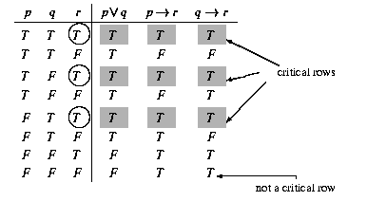
Example 1
Solution
From the table
we see all critical rows (in this case, those with the shaded positions all containing a T) correspond to (the circled) T(true) for r. Hence the argument is valid.

Slide 4
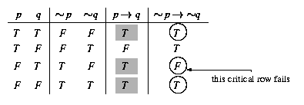

Example 2
Solution

Slide 5
Rules of Inference for Propositional Logic
We can always use a truth table to show that an argument form is valid. We do this by showing that whenever the premises are true, the conclusion must also be true.
However, this can be a tedious approach. For example, when an argument form involves 10 different propositional variables, to use a truth table to show this argument form is valid requires 2¹⁰ = 1024 different rows.
Fortunately, we do not have to resort to truth tables. Instead, we can first establish the validity of some relatively simple argument forms, called rules of inference.
These rules of inference can be used as building blocks to construct more complicated valid argument forms.

Slide 6
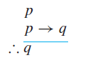
Modus ponens or law of detachment
premises: p, p → q conclusion: q
This is written as
Using this notation, the hypotheses are written in a column, followed by a horizontal bar, followed by a line that begins with the therefore symbol ‘∴’ and ends with the conclusion.

Slide 7
Example
Suppose that the conditional statement “If it snows today, then we will go skiing” and its hypothesis, “It is snowing today,” are true. Then, by modus ponens, it follows that the conclusion of the conditional statement, “We will go skiing,” is true.

Slide 8
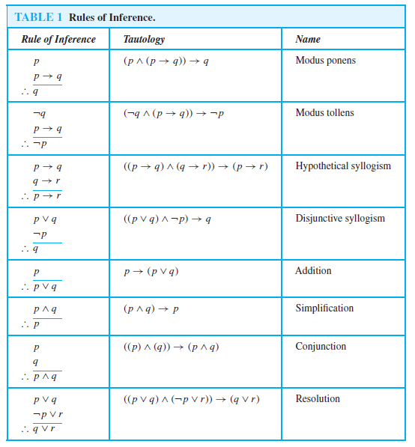
Rules of Inference

Slide 9

Example
State which rule of inference is the basis of the following argument: “It is below freezing now. Therefore, it is either below freezing or raining now.”
Solution
Let p be the proposition “It is below freezing now” and q the proposition “It is raining now.” Then this argument is of the form
This is an argument that uses the addition rule.

Slide 10

Example
State which rule of inference is the basis of the following argument: “It is below freezing and raining now. Therefore, it is below freezing now.”
Solution
Let p be the proposition “It is below freezing now,” and let q be the proposition “It is raining now.” This argument is of the form
This argument uses the simplification rule.

Slide 11

Example
State which rule of inference is used in the argument:
If it rains today, then we will not have a barbecue today. If we do not have a barbecue today, then we will have a barbecue tomorrow. Therefore, if it rains today, then we will have a barbecue tomorrow.
Solution
Let p be the proposition “It is raining today,” let q be the proposition “We will not have a barbecue today,” and let r be the proposition “We will have a barbecue tomorrow.” Then this argument is of the form
Hence, this argument is a hypothetical syllogism.

Slide 12
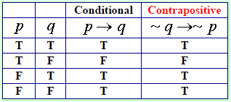
Contrapositive
Switching the hypothesis and conclusion of a conditional statement and negating both.
If the original statement is TRUE, the contrapositive is TRUE. If the original statement is FALSE, the contrapositive is FALSE. They are said to be logically equivalent.

Slide 13
Using Rules of Inference to Build Arguments
When there are many premises, several rules of inference are often needed to show that an argument is valid.
Example
Show that the premises “It is not sunny this afternoon and it is colder than yesterday,” “We will go swimming only if it is sunny,” “If we do not go swimming, then we will take a canoe trip,” and “If we take a canoe trip, then we will be home by sunset” lead to the conclusion “We will
be home by sunset.”

Slide 14
Example
Show that the premises “It is not sunny this afternoon and it is colder than yesterday,” “We will go swimming only if it is sunny,” “If we do not go swimming, then we will take a canoe trip,” and “If we take a canoe trip, then we will be home by sunset” lead to the conclusion “We will be home by sunset.”
Solution
Let
p be the proposition “It is sunny this afternoon,”
q the proposition “It is colder than yesterday,”
r the proposition “We will go swimming,”
s the proposition “We will take a canoe trip,”
and t the proposition “We will be home by sunset.”
Then the premises become
￢p ∧ q, r → p, ￢ r → s, and s → t . The conclusion is simply t .
We need to give a valid argument with premises ￢p ∧ q, r → p, ￢r → s, and s → t and conclusion t .

Slide 15
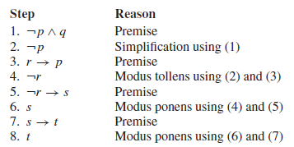
Continue
We construct an argument to show that our premises lead to the desired conclusion as follows.

Slide 16
Example
Show that the premises “If you send me an e-mail message, then I will finish writing the program,” “If you do not send me an e-mail message, then I will go to sleep early,” and “If I go to sleep early, then I will wake up feeling refreshed” lead to the conclusion “If I do not finish writing the program, then I will wake up feeling refreshed.”
Solution
Let p be the proposition “You send me an e-mail message,”
q the proposition “I will finish writing the program,”
r the proposition “I will go to sleep early,” and
s the proposition “I will wake up feeling refreshed.”
Then the premises are p → q,￢ p → r, and r → s.
The desired conclusion is ￢q → s.
We need to give a valid argument with premises p → q, ￢p → r, and r → s and conclusion ￢q → s.

Slide 17
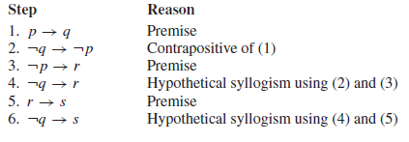
Solution Continue
This argument form shows that the premises lead to the desired conclusion.

Slide 18

Resolution
Computer programs have been developed to automate the task of reasoning and proving theorems.
Many of these programs make use of a rule of inference known as resolution.
This rule of inference is based on the tautology
The final disjunction in the resolution rule, q ∨ r, is called the resolvent.
When we let q = r in this tautology, we obtain (p ∨ q) ∧ (￢p ∨ q) → q.
Furthermore, when we let r = F, we obtain (p ∨ q) ∧ (￢p) → q (because q ∨ F ≡ q), which is the tautology on which the rule of disjunctive syllogism is based.
Reasoning: The process of thinking about something in a logical way in order to form a conclusion or judgement.

Slide 19
Example
Use resolution to show that the hypotheses “Jasmine is skiing or it is not snowing” and “It is snowing or Bart is playing hockey” imply that “Jasmine is skiing or Bart is playing hockey.”
Solution
Let p be the proposition “It is snowing,” q the proposition “Jasmine is skiing,” and r the proposition “Bart is playing hockey.”
We can represent the hypotheses as ￢p ∨ q and p ∨ r, respectively.
Using resolution, the proposition q ∨ r, “Jasmine is skiing or Bart is playing hockey,” follows.

Slide 20
Rules of Inference for Quantified Statements
Universal Instantiation
Universal instantiation is the rule of inference used to conclude that P(c) is true, where c is a particular member of the domain, given the premise ∀xP(x).
Universal instantiation is used when we conclude from the statement “All women are wise” that “Lisa is wise,” where Lisa is a member of the domain of all women.

Slide 21
Rules of Inference for Quantified Statements
Universal generalization
Universal generalization is the rule of inference that states that ∀xP(x) is true, given the premise that P(c) is true for all elements c in the domain.
Universal generalization is used when we show that ∀xP(x) is true by taking an arbitrary element c from the domain and showing that P(c) is true.
The element c that we select must be an arbitrary, and not a specific, element of the domain.
That is, when we assert from ∀xP(x) the existence of an element c in the domain, we have no control over c and cannot make any other assumptions about c other than it comes from the domain.

Slide 22
Rules of Inference for Quantified Statements
Existential instantiation
Existential instantiation is the rule that allows us to conclude that there is an element c in the domain for which P(c) is true if we know that ∃xP(x) is true.
We cannot select an arbitrary value of c here, but rather it must be a c for which P(c) is true. We don’t have knowledge of what c is only it exists.

Slide 23
Rules of Inference for Quantified Statements
Existential generalization
Existential generalization is the rule of inference that is used to conclude that ∃xP(x) is true when a particular element c with P(c) true is known.
That is, if we know one element c in the domain for which P(c) is true, then we know that ∃xP(x) is true.

Slide 24
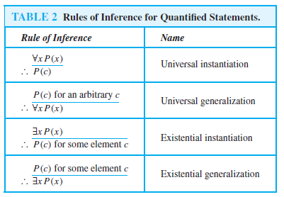
Rules of Inference for Quantified Statements

Slide 25
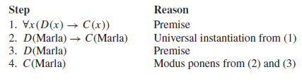
Example
Show that the premises “Everyone in this discrete mathematics class has taken a course in computer science” and “Marla is a student in this class” imply the conclusion “Marla has taken a course in computer science.”
Solution
Let D(x) denote “x is in this discrete mathematics class,” and let C(x) denote “x has taken a course in computer science.”
Then the premises are ∀x(D(x) → C(x)) and D(Marla).
The conclusion is C(Marla).
The following steps can be used to establish the conclusion from the premises.

Slide 26
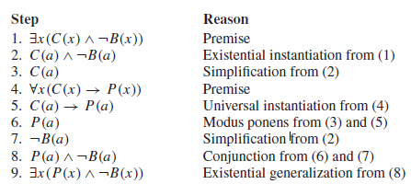
Example
Show that the premises “A student in this class has not read the book,” and “Everyone in this class passed the first exam” imply the conclusion “Someone who passed the first exam has not read the book.”
Solution
Let C(x) be “x is in this class,” B(x) be “x has read the book,” and P(x) be “x passed the first exam.”
The premises are ∃x(C(x)∧￢B(x)) and ∀x(C(x) →P(x)).
The conclusion is ∃x(P(x)∧￢B(x)).

Slide 27

Universal modus ponens
Because universal instantiation and modus ponens are used so often together, this combination of rules is sometimes called universal modus ponens.
This rule tells us that if ∀x(P(x) → Q(x)) is true, and if P(a) is true for a particular element a in the domain of the universal quantifier, then Q(a) must also be true.

Slide 28

Universal modus tollens
Universal modus tollens combines universal instantiation and modus tollens and can be expressed in the following way:

